Slide 1
Lecture A04:
Error Handling
ITP271 :: Web Application Development & Project

Slide 2
Overview
Dealing with Errors
ASP.NET Error Handling
  Customised Default Error Page
  C# Exception Handling

Slide 3
Dealing with Errors
There are many possible errors that can happen in any application
  Not all have a specific solution
  Not all are predictable
Handle ALL errors in a user-friendly manner and as informative as possible
  Reduce user's frustrations and increase likelihood of staying/returning
Create specific responses for errors that can be:
  Predicted
  Has a specific solution
Create generic responses for errors that:
  Cannot be predicted,
  Has no specific solution

Slide 4
Error Handling in ASP.NET Web Applications
Generic Error Handling
  Customised Default Error Page
Specific Error Handling
  C# Except Handling: try… catch statement

Slide 5
Customised Default Error Page
A generic web page to display a user-friendly message to the user
Handles errors that are:
  Unhandled
  Not predicted
  Has no solution
Usually a .html page (instead of .aspx)
  Advantage: Will still work even if the ASP.NET module/engine of the web server is not functioning
  Disadvantage: Not able to use ASP.NET features like Master Pages

Slide 6
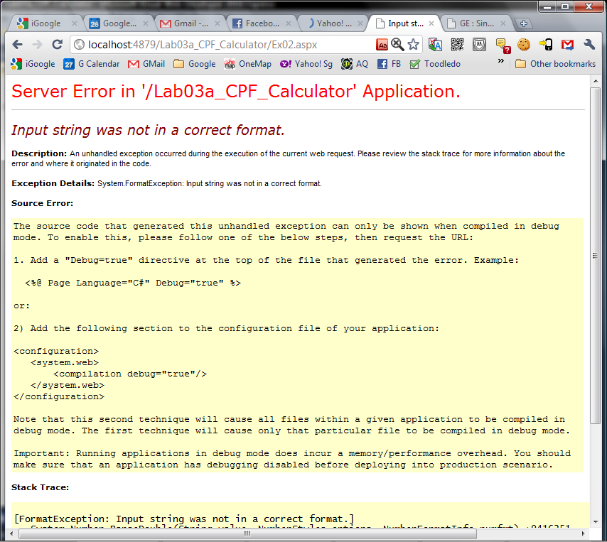
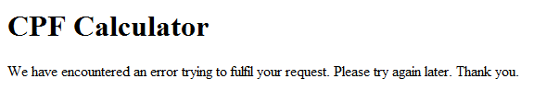
Customised Default Error Page
ASP.NET default error page
Customised Default Error Page

Slide 7
C# Exception Handling
When C# code encounters an error, it will throw an exception
We use the try… catch statement to catch the exception and write code to handle it
(Throwing and Catching Exceptions are the standard way of handling errors in current versions of many mainstream programming languages)

Slide 8
try… catch Statement
Format:
try
{
  // normal program code
}
catch ([type of exception] ex1)
{
  // error handling code
}
catch ([type of exception] ex2)
{
  // error handling code
}

Slide 9
try… catch Statement
Example:
try
{
  age = Convert.Int32(tbAge.Text);
}
catch (FormatException fmtEx)
{
  lblErrMsg.Text = "Please enter a number.";
}
catch (Exception ex)
{
  lblErrMsg.Text = "Unknown error. Please try again.";
}

Slide 10
How to DEBUG in ASP.NET
How to debug code in Visual Studio
https://www.youtube.com/watch?v=GPnTiFxkn9Y
Breakpoint Configuration Experience in Visual Studio 2015
https://www.youtube.com/watch?v=FKAOHtxiloA

Slide 11
Summary
Handle ALL errors
  Create specific responses for predictable errors that have specific solutions
  Create generic response for unpredictable errors or errors that do not have a specific solution.
Customised Default Error Page
C# Exception Handling

Slide 12
Debugger Shortcut Keys
https://shortcutworld.com/en/Visual-Studio/2015/win/all#link_5
What shortcut to start debugger and run the application?
What is the shortcut key to continue execution?
What is the shortcut key to step into?
What is the shortcut key to step over?

